Slide 1
Plant Disease Detection Using Deep Learning
DISSERTATION
Submitted in partial fulfillment of the requirements for the award of the degree of
Bachelor of technology
in
Computer Science and Engineering
Under the guidance of : Submitted By:
Ms. Jyotsna Gurman Singh (111/CSE2/2019)
Harneet Singh (103/CSE2/2019)
Kuldeep Singh (117/CSE2/2019)
Sahibjot Singh (065/CSE2/2019)
Department of Computer Science & Engineering
Guru Tegh Bahadur Institute of Technology
Guru Gobind Singh Indraprastha University
Dwarka, New Delhi
Year 2022-2023

Slide 2
Introduction
The project aims to develop a Plant Disease Detection system using Convolutional Neural Networks (CNNs) to identify diseases affecting crops accurately.
The system will utilize the Plant Village Dataset, consisting of 39 classes of plant leaf and background images, to train the model for disease detection.
The project includes the implementation of a user-friendly website and mobile application, allowing farmers to easily capture and upload images of plant leaves for disease diagnosis.
The system will provide instant feedback on disease presence and offer detailed information on disease management strategies, treatments, and preventive measures.
By enabling early intervention and targeted disease management, the project aims to reduce crop losses, optimize resource utilization, and enhance global food security.

Slide 3
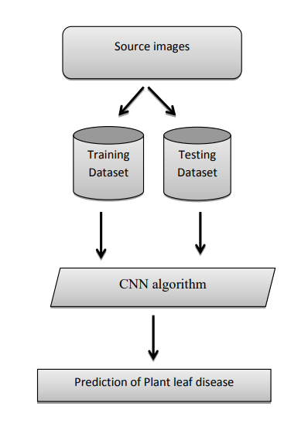
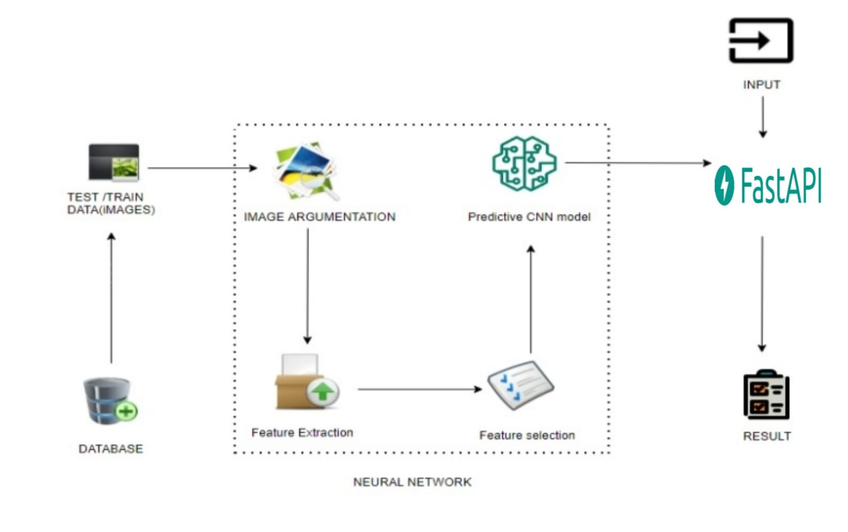
System Architecture and Work Flow Diagram
System Architecture
Work Flow Diagram

Slide 4
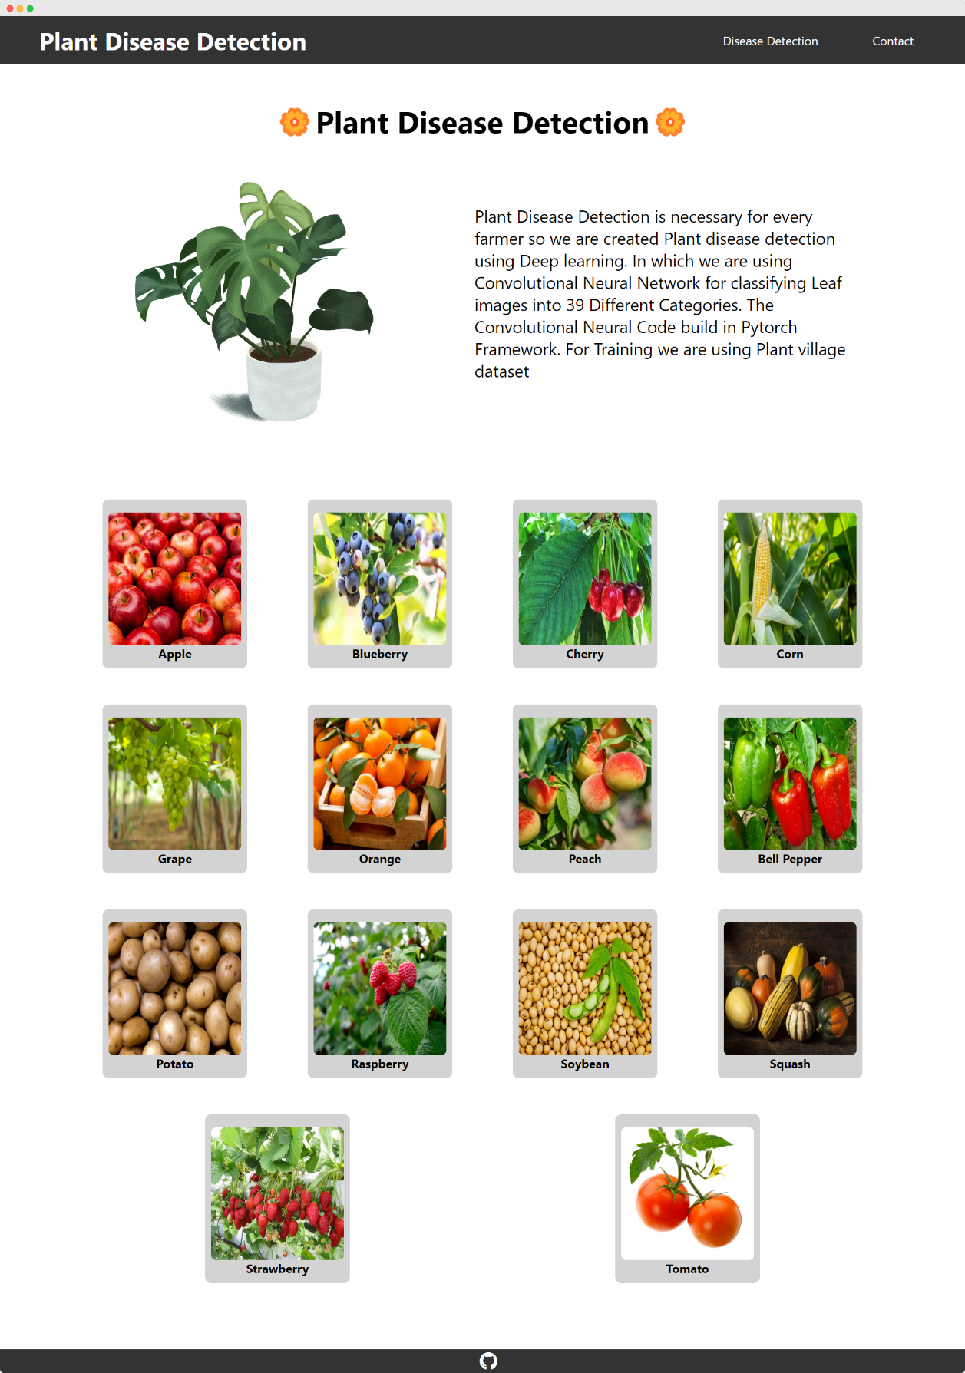
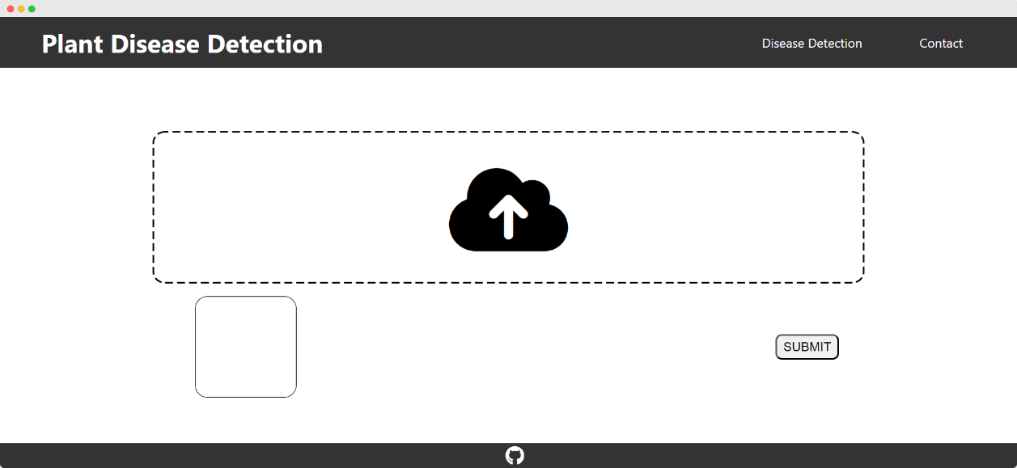
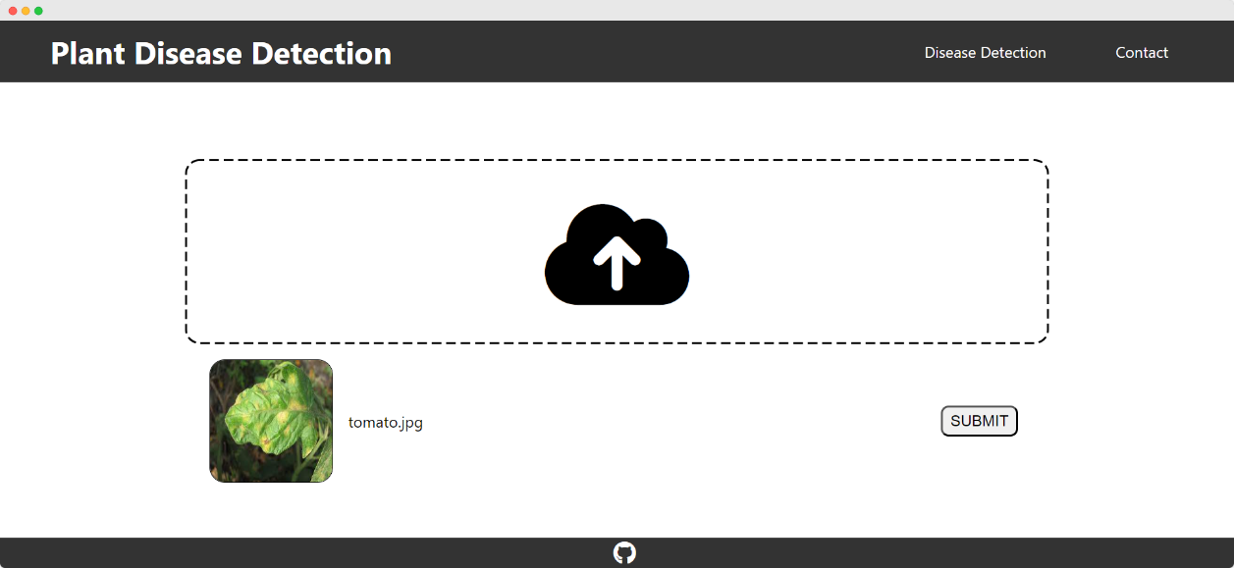
UI Screenshots

Slide 5
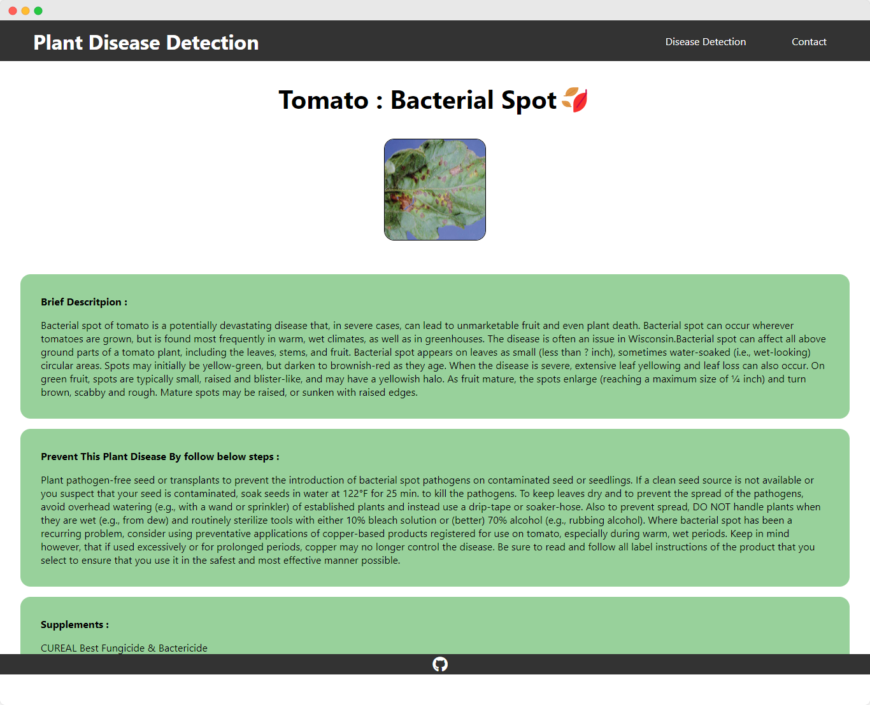

Slide 6
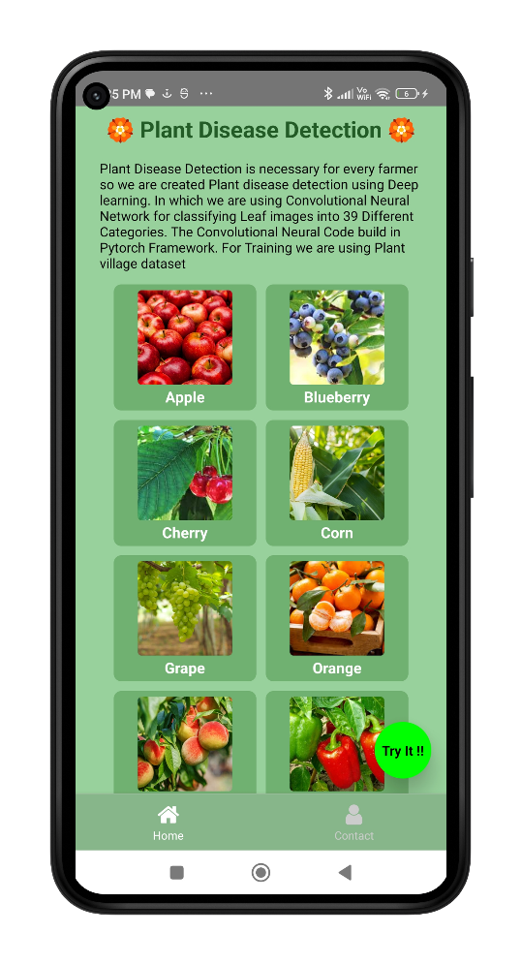
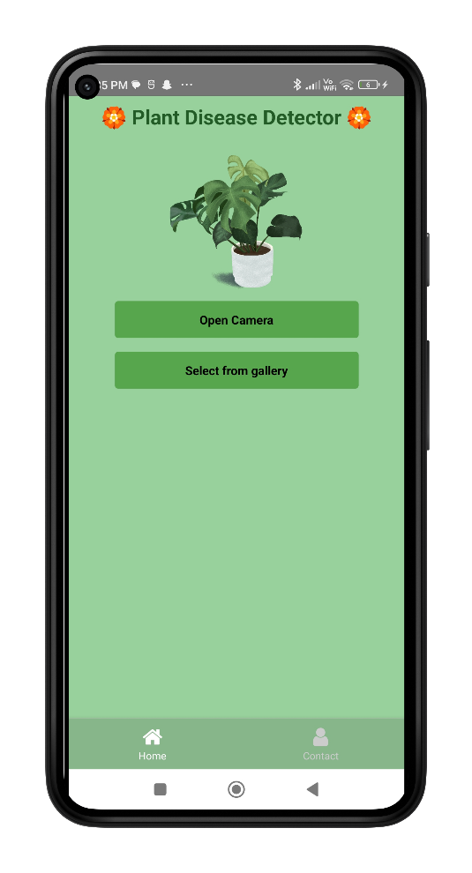
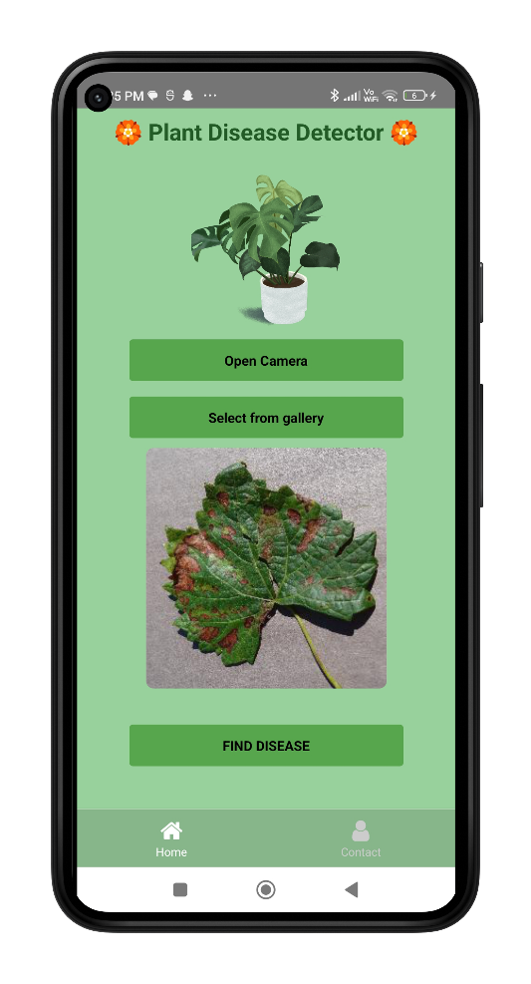
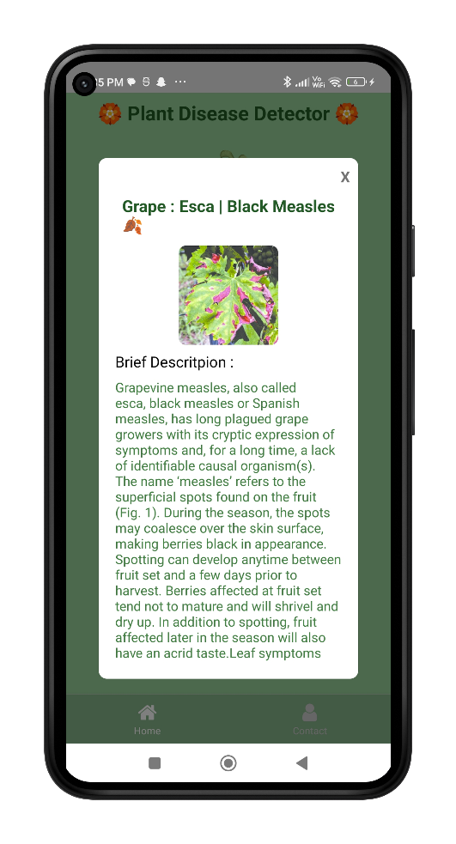


Slide 7







Software and Tech Stack Used
Python 3.7(VSCode, pip)
Machine Learning
PyTorch
FastAPI
OpenCV
Jupyter Notebook
React.js
React Native
TypeScript
Android Studio
Visual Studio Code
Git

Slide 8
Future Scope
As the system evolves, there is potential to incorporate a wider range of crop diseases beyond the initial focus on powdery mildew, leaf spot, blight, and rust.
Future enhancements could involve integrating sensors and IoT technologies to enable real-time monitoring of plant health. This would provide continuous data collection and analysis, allowing for early disease detection and proactive disease management.
Combining the Plant Disease Detection system with precision farming techniques, such as satellite imagery and drone-based monitoring, could provide a comprehensive approach to crop management.
Ongoing advancements in machine learning, such as the development of more advanced CNN architectures and techniques like transfer learning, will contribute to the continuous improvement of the Plant Disease Detection system.
These advancements will enhance the accuracy and efficiency of disease detection and diagnosis, further benefiting farmers in their disease management efforts.

Slide 9
References
Acharya, D., & Pant, A. (2017). Deep learning-based classification for plant diseases. Proceedings of the 2017 International Conference on Advances in Computing, Communications and Informatics (ICACCI), 1575-1580.
A.K. Mishra, V. D. Bharadi, and M. B. Nagori, "Plant Disease Detection Techniques: A Review," Indian Journal of Science and Technology, vol. 9, no. 45, 2016.
"Automated Identification of Plant Diseases using Machine Learning Techniques" by Anupama Vijaya Kumar.
"Computer Vision: Models, Learning, and Inference" by Simon J.D. Prince.
"Deep Learning Models for Plant Disease Detection and Diagnosis" by Ferentinos, K. P. (2018).
"Deep learning models for plant disease detection and diagnosis" by Ferentinos, K. P. (2020). In Advances in Experimental Medicine and Biology, 1138, 21-35.
"Deep learning in agriculture: A survey" by Kamilaris, A., & Prenafeta-Boldú, F. X. (2018).
"Going Deeper with Convolutions" by C. Szegedy et al., in Proceedings of the IEEE Conference on Computer Vision and Pattern Recognition (CVPR), 2015.
"Image Analysis, Classification, and Change Detection in Remote Sensing: With Algorithms for ENVI/IDL and Python" by Morton J. Canty.
"Learning React Native: Building Native Mobile Apps with JavaScript" by Bonnie Eisenman.

